Slide 1

TOPIC-Extract Transform Load(ETL)
BY Nandini Dutta

Slide 2
Contents
Introduction
Need of ETL
Data Warehouse
Data Mart
ETL process
ELT(Extract Load Transform)
ETL vs ELT
ETL Testing
ETL Bugs
ETL Tools
ETL Demo Using SQL(Structured Query Language)

Slide 3
Introduction
ETL = Extract Transform Load.
ETL is a process that extracts the data from different source systems, then transforms the data (like applying calculations, concatenations, etc.) and finally loads the data into the Data Warehouse system.

Slide 4
Why Do You Need ETL?
It helps companies to analyze their business data for taking critical business decisions.
ETL provides a method of moving the data from various sources into a data warehouse.
ETL process allows sample data comparison between the source and the target system.
ETL in data warehouse offers deep historical context for the business.
It helps to improve productivity because it codifies and reuses without a need for technical skills.

Slide 5
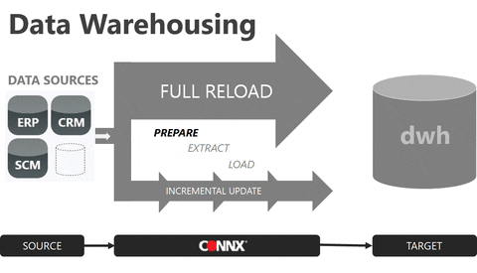
What is a Data Warehouse?
A data warehouse is typically a relational database that is designed for query and analysis rather than for transaction processing.
A place where historical data is stored for archival, analysis and security purposes.
contains either raw data or formatted data
combines data from multiple sources (i.e. Sales data, salaries, social networks etc.).

Slide 6
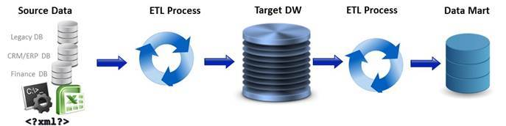
Data Mart
A data mart is a subset of a data warehouse that has the same characteristics but is usually smaller and is focused on the data for one division or one workgroup within an enterprise.

Slide 7
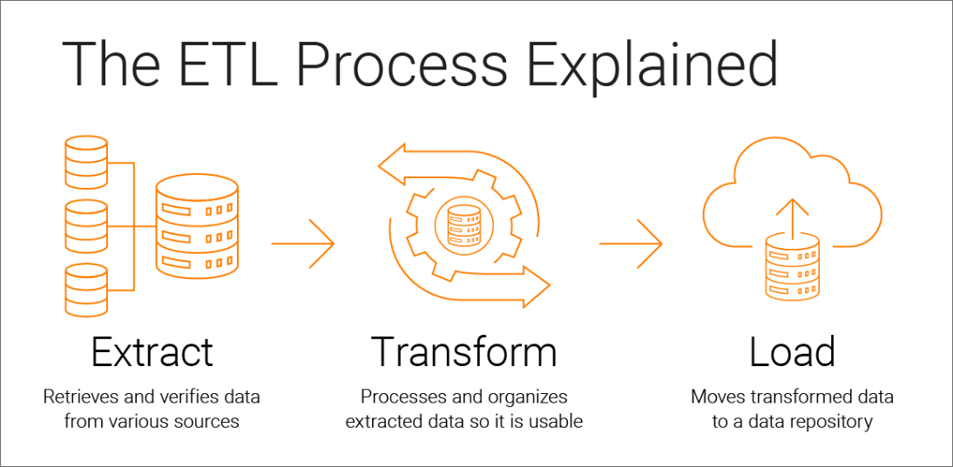
How Does the ETL Process Work?

Slide 8
ETL is a Three Step Process
Step 1
Extract – ETL developers extract data from one or more systems and/or files and copy it into the data warehouse .
Some Validations are Done During Extraction:
Reconcile records with the source data.
Make sure that no spam/unwanted data loaded.
Data type check.
Remove all types of duplicate/fragmented data.
Check whether all the keys are in place or not.

Slide 9
Step 2
Transform – ETL developers remove inconsistencies, assemble to a common format, adding missing fields, summarizing detailed data and deriving new fields to store calculated data.
Data that does not require any transformation is called as direct move or pass through data.
Some Validations are Done During Transformation
Filtering.
Unit Conversion.
Required fields should not be left blank.
Cleaning .
Column Splitting and Merging.

Slide 10
Step 3
Load – Loading data into the target data warehouse database is the last step of the ETL process.
Types of Loading:
Initial Load
Incremental Load
Full Refresh

Slide 11
Load Verification
Key Field Validation.
Modeling View Testing.
Combined Values and Calculated Measures.
Dimension and History Table Checks.
BI(Business Intelligence) Report Validation.
Note: Business Intelligence (BI) is a technology-driven process for analyzing and presenting business data to help organizations make informed decisions.

Slide 12
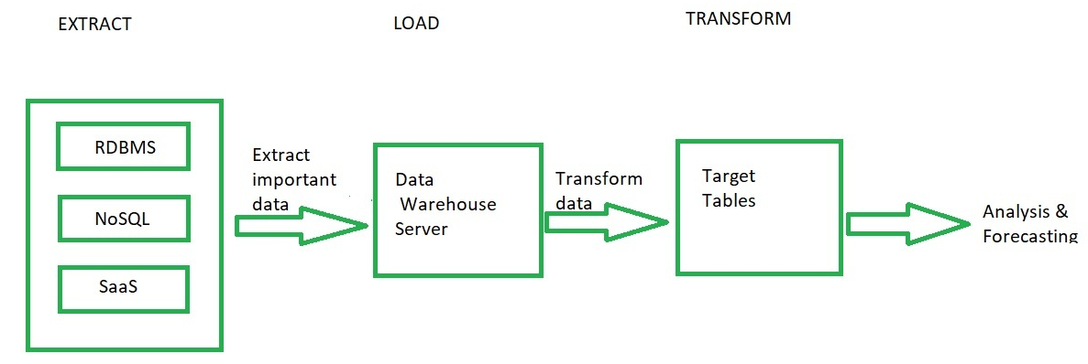
What Is ELT (Extract, Load, Transform)?
Extraction, Load and Transform (ELT) is the technique of extracting raw data from the source and storing it in data warehouse of the target server and preparing it for endstream users.

Slide 13

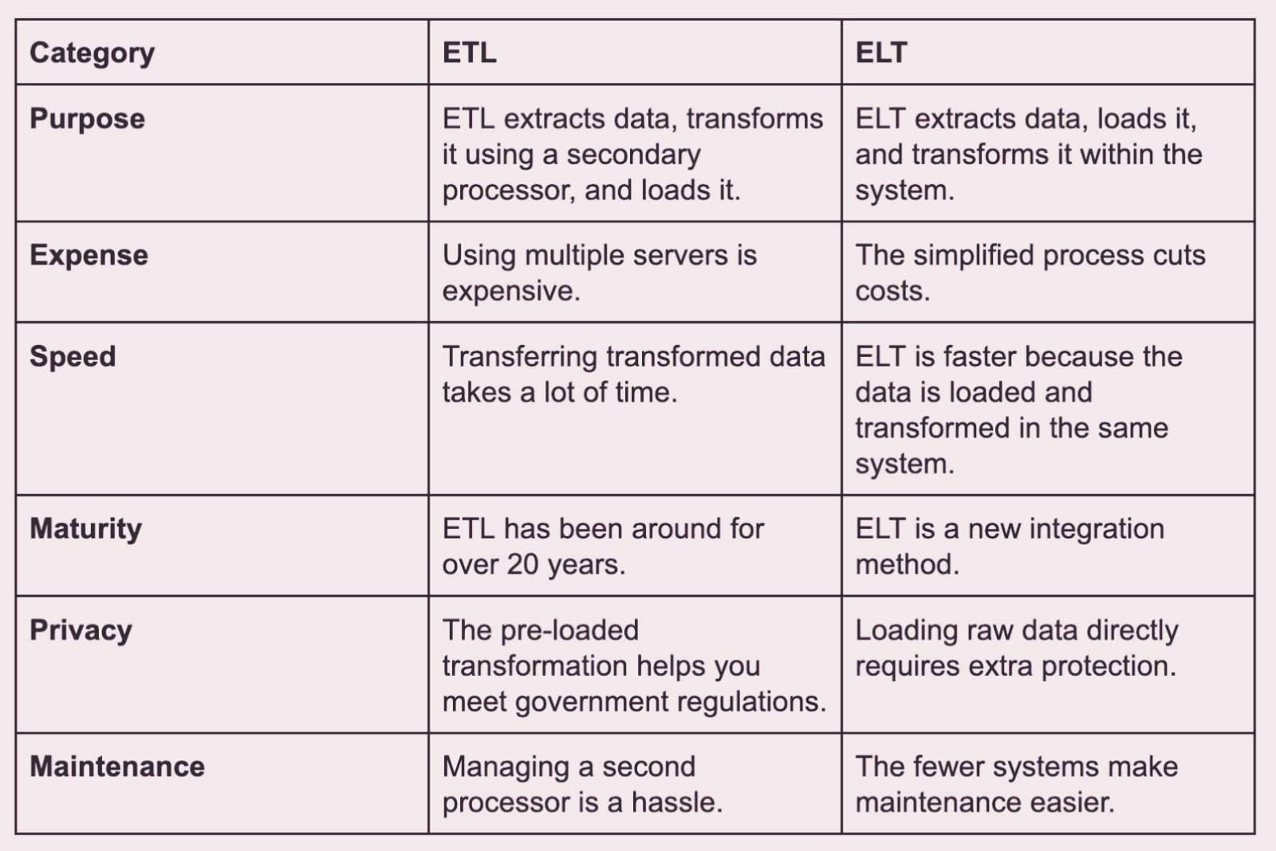
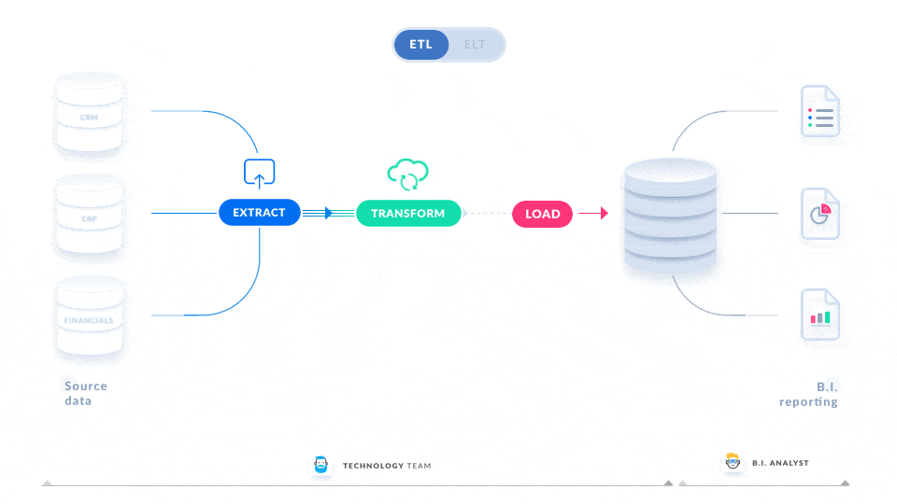

Slide 14
When to Choose ETL over ELT
We might choose ETL (Extract, Transform, Load) over ELT (Extract, Load, Transform) when the data requires :
Significant transformation.
Quality control before loading into the target system .
Better governance.
Performance optimization capabilities.

Slide 15
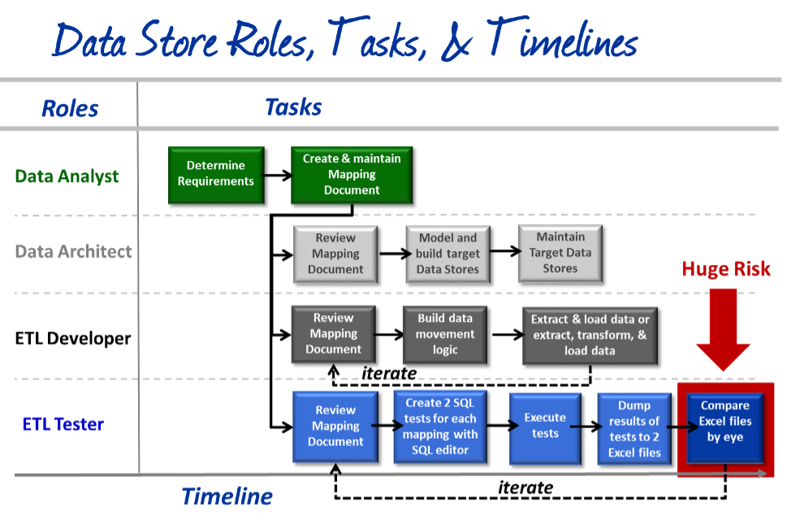
Who are Involved in the ETL Process? There are at least 4 roles involved 1)Data Analyst 2)Data Architect 3)ETL Developer 4)ETL Tester

Slide 16
What is ETL Testing?
ETL testing is done to ensure that the data that has been loaded from a source to the destination after business transformation is accurate. It also involves the verification of data at various middle stages that are being used between source and destination.
What are the key Benefits of ETL Testing?
Minimize the risk of the data loss
Data security
Data Accuracy
Reporting efficiency

Slide 17
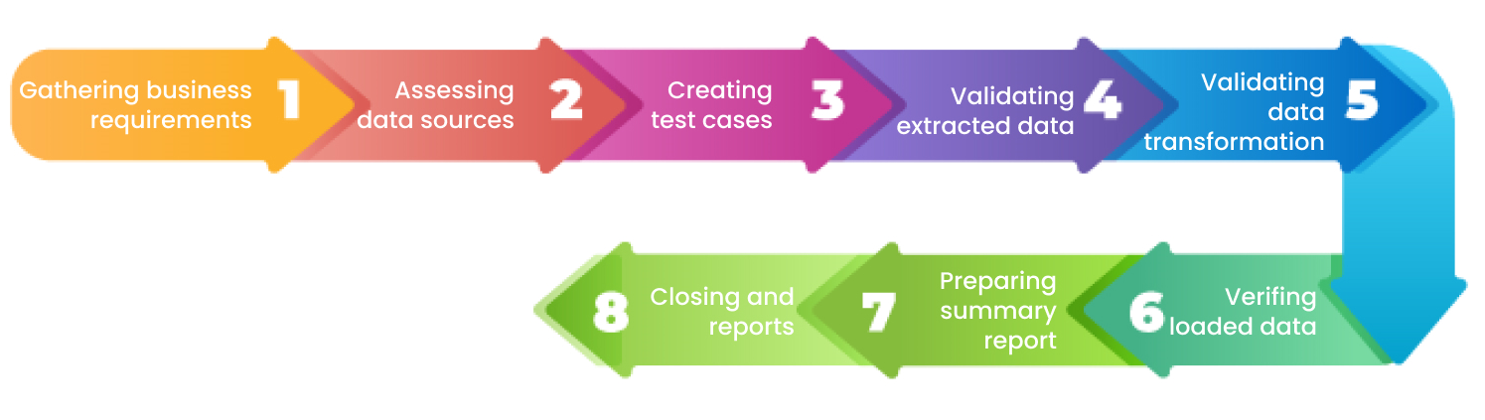
Stages of ETL Testing

Slide 18
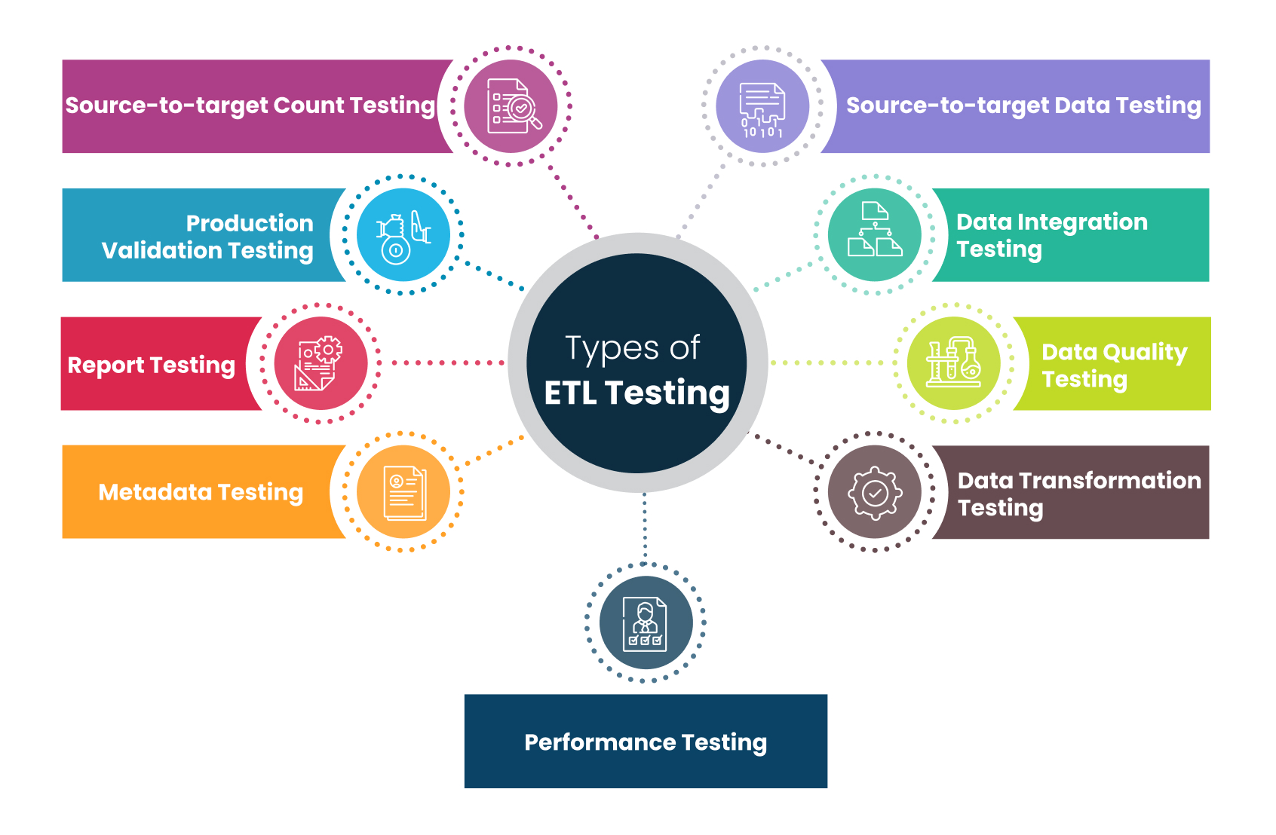
Types of ETL Testing

Slide 19
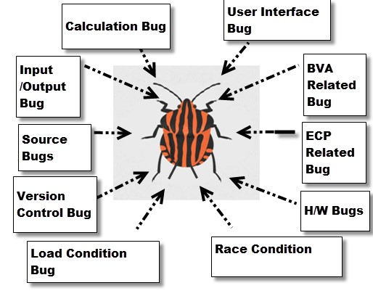
Types of ETL Bugs

Slide 20
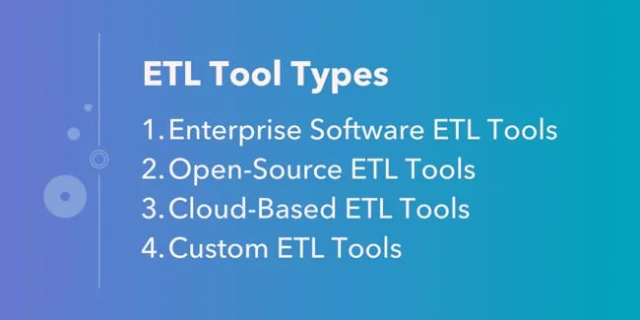
What are ETL Tools?
ETL tools are software applications designed to automate and streamline the process of data integration. They simplify the extraction of data from various sources, transform it into a usable format, and load it into a destination system.

Slide 21
How to Evaluate ETL Tools
Every organization has a unique business model and culture, and the data that a company collects and values will reflect this. However, there are common criteria that you can measure ETL tools against that will be relevant to each organization, which are outlined below.
Use case
Budget
Capabilities
Data sources
Technical literacy

Slide 22
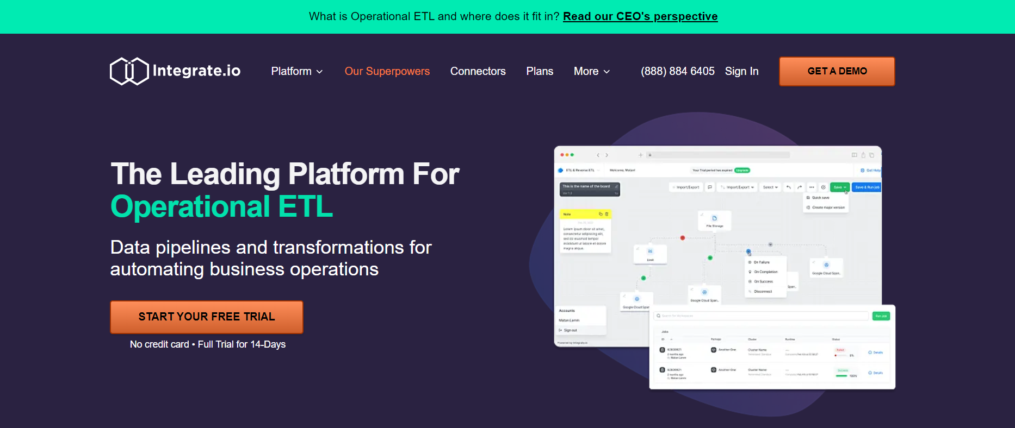
ETL Tools
Integrate.io
Price: Free 14-day trial & flexible paid plans available
Type: Cloud.
Use: Moves and transforms data between systems.

Slide 23
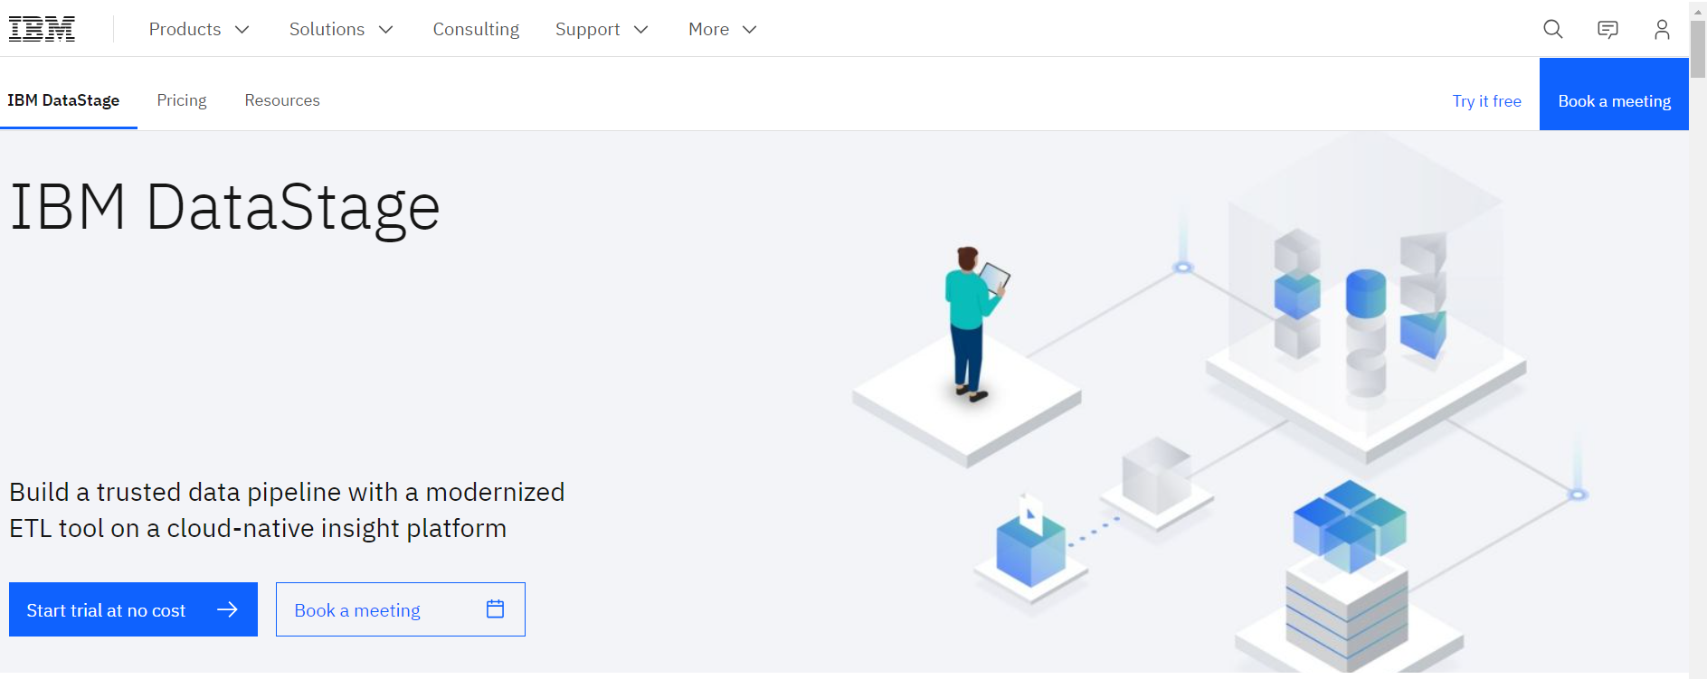
IBM DataStage
Price: Free trial with paid plans available.
Type: Enterprise.
Use: For extracting, transforming, and loading data across various sources and targets.

Slide 24
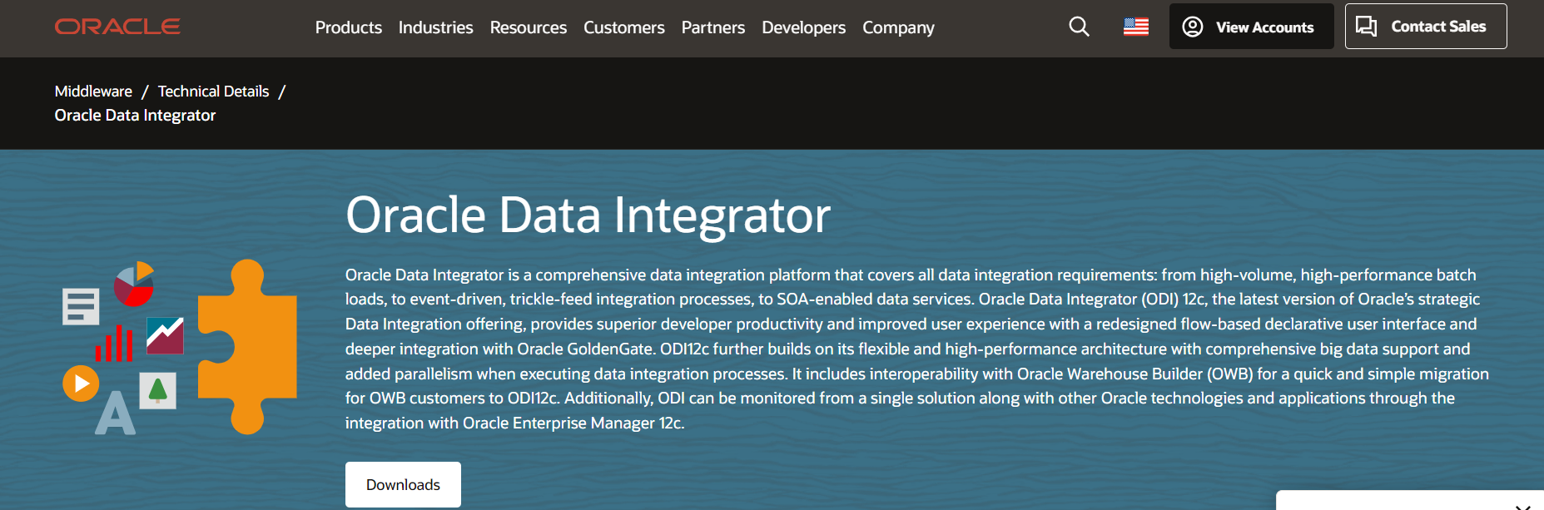
Oracle Data Integrator
Price: Pricing available on request.
Type: Enterprise
Use: It is a platform designed to build, manage, and maintain data integration workflows across organizations.

Slide 25
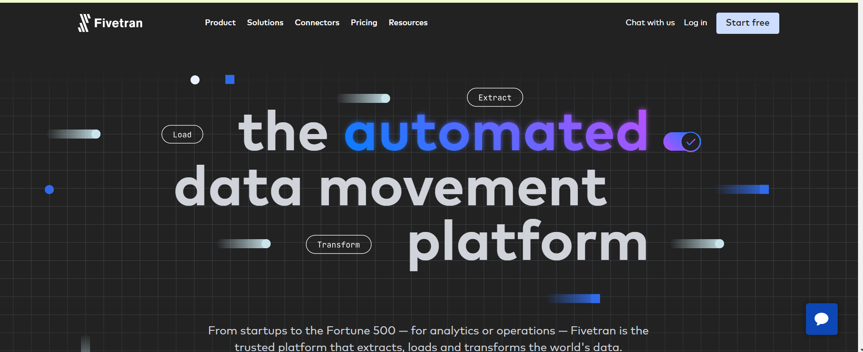
Fivetran
Price: 60$/month for Standard Select plan; 120$/month for Starter plan; 180$/month for Standard plan; $240/month for Enterprise plan.
Type: Enterprise.
Use: It aims to add convenience to your data management process with its platform of handy tools.

Slide 26
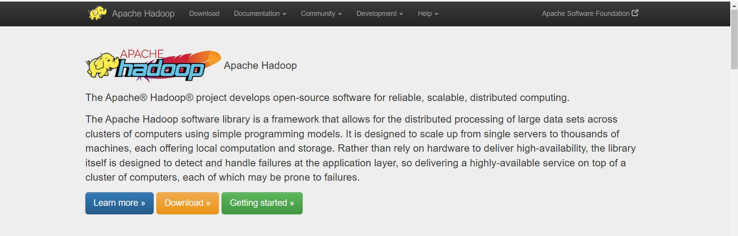
Hadoop
Price: Free.
Type: Open Source.
Use: Used for storing and processing big data across distributed computing clusters.

Slide 27
ETL Demo Using SQL
SQL, as an ETL (Extract, Transform, Load) tool, enables data extraction from various sources, transformation through queries and operations, and loading into target databases or destinations.
Queries that are used in ETL
Extraction- Select Query
Transformation- Select Query
Load- Insert Query

Slide 28
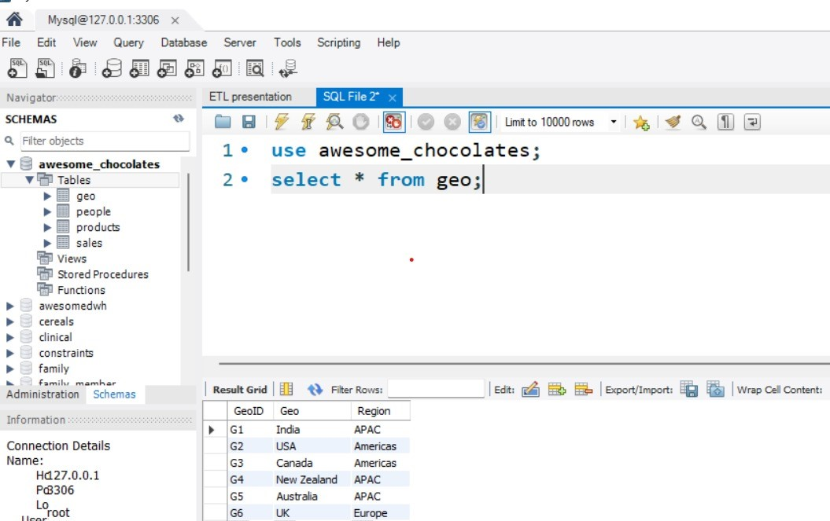
Table geo in awesome_chocolates database

Slide 29
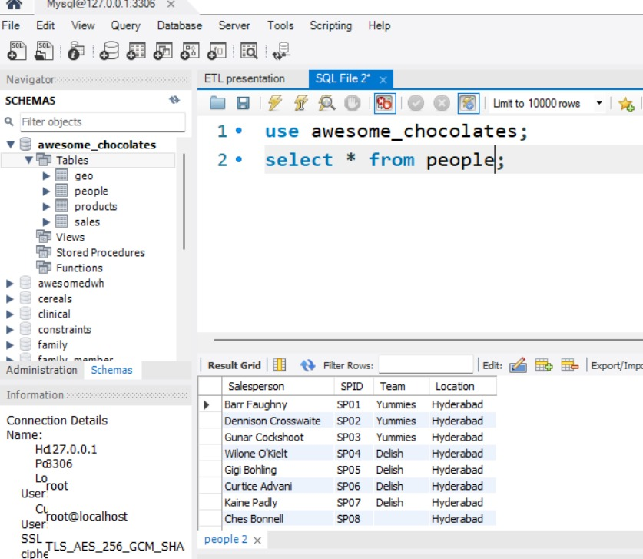
Table people in awesome_chocolates database

Slide 30
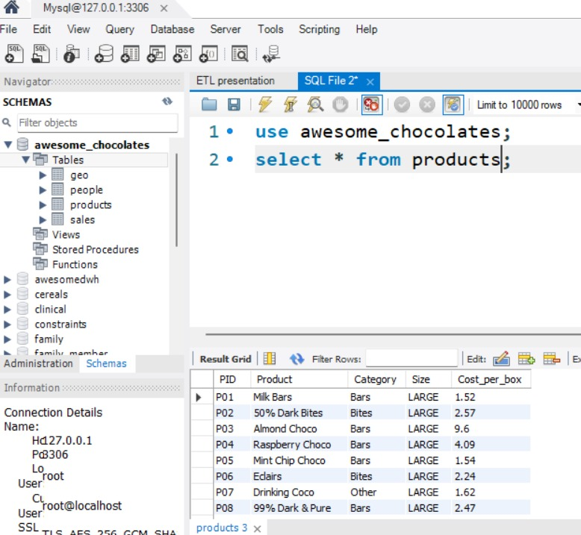
Table products in awesome_chocolates database

Slide 31
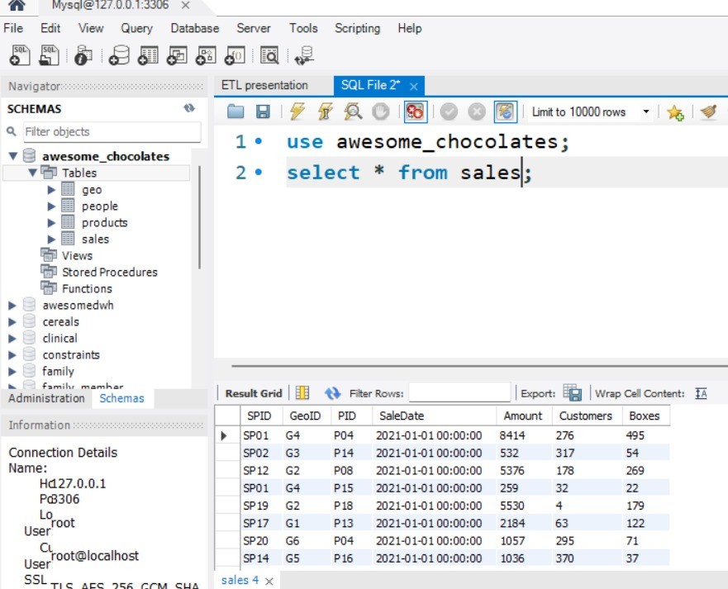
Table sales in awesome_chocolates database

Slide 32
Now we want to set up a data warehouse called awesomedwh in this data warehouse I have a simple table called monthly_summary3 .
Where we want to show these columns

Slide 33
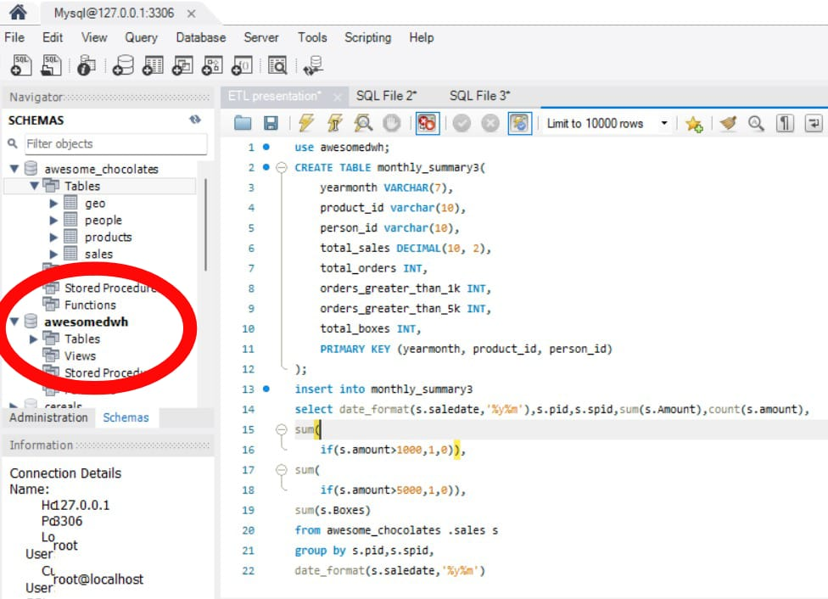
Now simply with one line of code in SQL we will take the information from the sales table of awesome_chocolates database to ,monthly_summary3 table which is in the new data warehouse called awesomedwh.

Slide 34
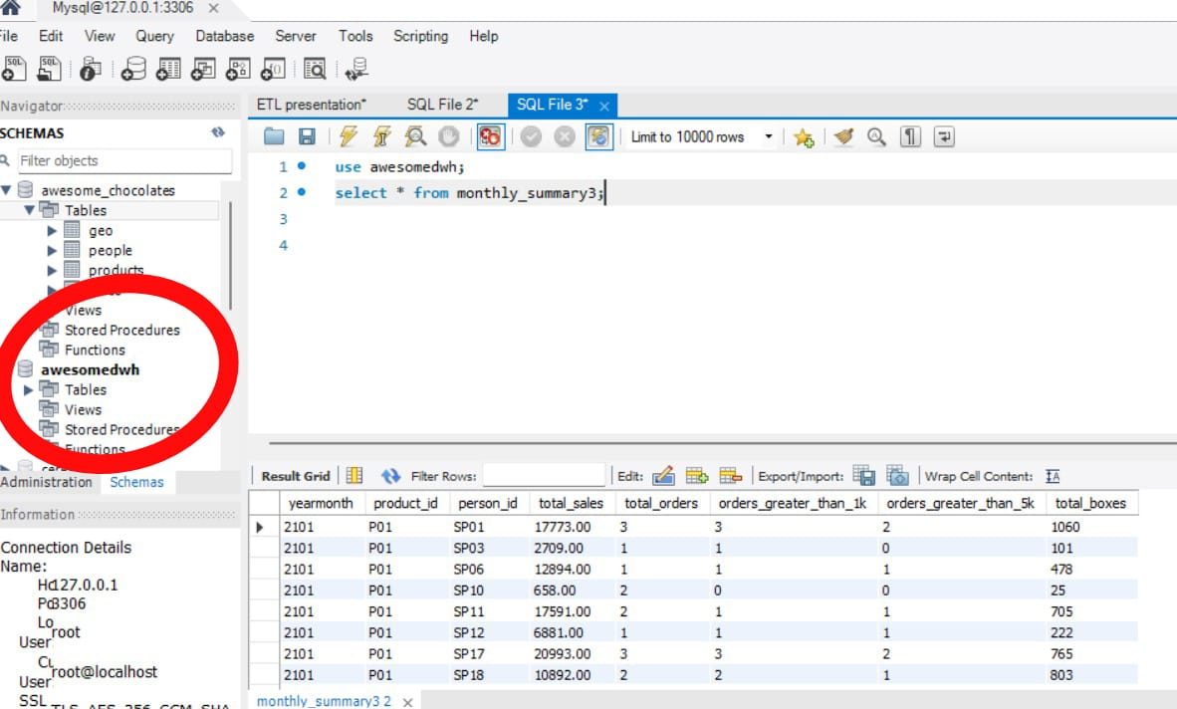
Finally we have the table with required information.

Slide 35
Conclusion
ETL is the backbone of data integration, facilitating the seamless flow of information across systems. In simple terms, ETL (Extract, Transform, Load) is like a data mover and transformer. It takes information from various places, changes it to fit where it's needed, and puts it there Its ability to extract, transform, and load data empowers businesses to streamline operations, improve decision-making, and unlock the full potential of their data assets.
Reference Links:
https://www.guru99.com/etl-extract-load-process.html
https://www.querysurge.com/solutions/etl-testing?utm_source=QS-Site&utm_medium=web-page&utm_campaign=ETL-Testing-Everything-you-need-to-know
https://blog.hubspot.com/website/etl-tools
Youtube Links:
https://youtu.be/wDTzxdShbd8?si=tSM8TME9_znao0gZ

Slide 36


